Slide 1

Marketing Analytics Team Project
Anna Rose, Drew Shuryn, Nicholas Opalewski, Ryan Ferguson, Brandon Reyes
Notes:
Anna

Slide 2

Executive Summary/Situation
Scenario – Walmart has 45 stores across the Unites States where it implements 5 different markdown periods throughout the year at each store. They are aware that mark-downs can have a significant influence on weekly sales so the company would like to be more strategic with their markdown approach to enhance revenue per store.
The following question will be answered in order to provide Walmart with direction:
In order to improve weekly sales of stores with similar attributes, what markdown periods should be optimized or potentially removed from the markdown strategy?
Walmart Data Set: https://www.kaggle.com/manjeetsingh/retaildataset?select=Features+data+set.csv​
Notes:
Anna

Slide 3
Research Objective, Plan, and Methodology
Objectives
Outline significant markdown periods that lead to increased sales growth within store clusters
Identify markdown periods in each cluster that are over or underperforming and their individual impact on sales.
Use findings to provide Walmart with recommendations as how to best optimize markdown strategies among each cluster
Plan and Methodology
Conduct a k-means clustering analysis to determine store clusters
Analyze results and re-cluster stores based on results
Outline similarities within and between clusters
Perform a linear regression on each individual cluster
Using Weekly Sales as the dependent variable and Markdown Periods as independent variables
Report on variables that may or may not be significant in regard to weekly sales
Observe if there are any significant interactions between these predictors with respect to their effect on sales.
Notes:
Anna

Slide 4
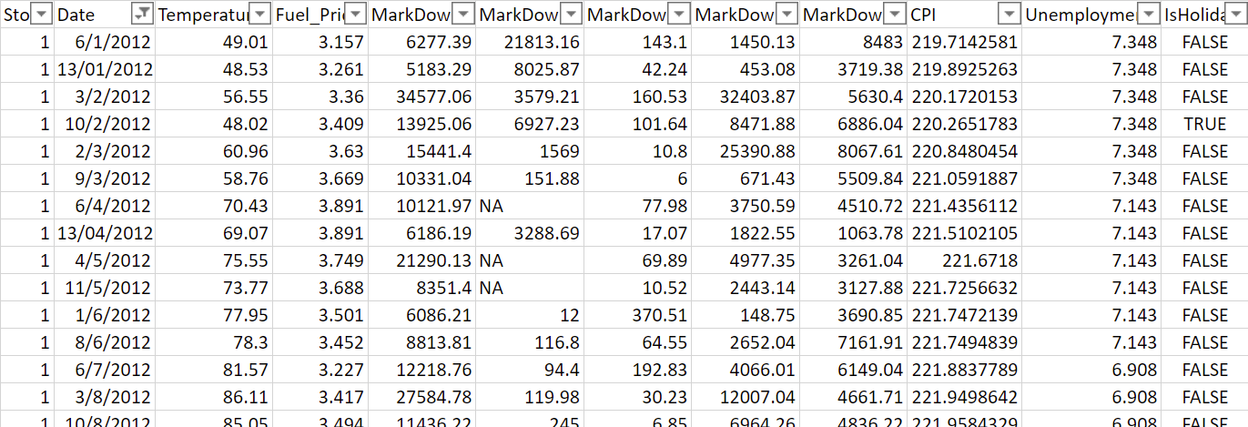
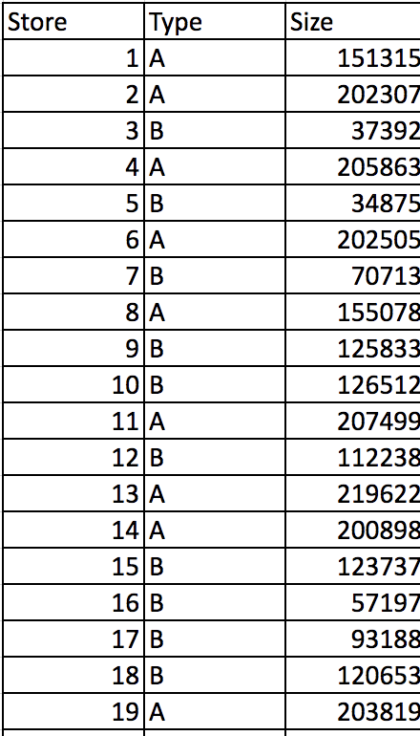
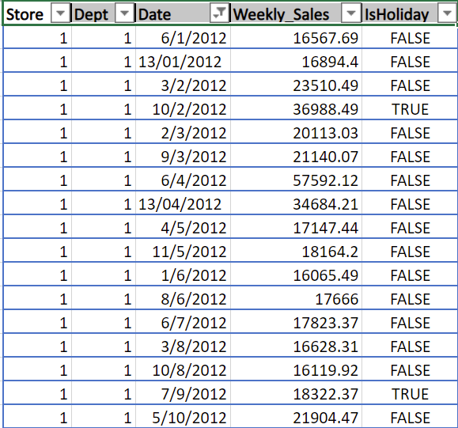
Notes:
Drew

Slide 5
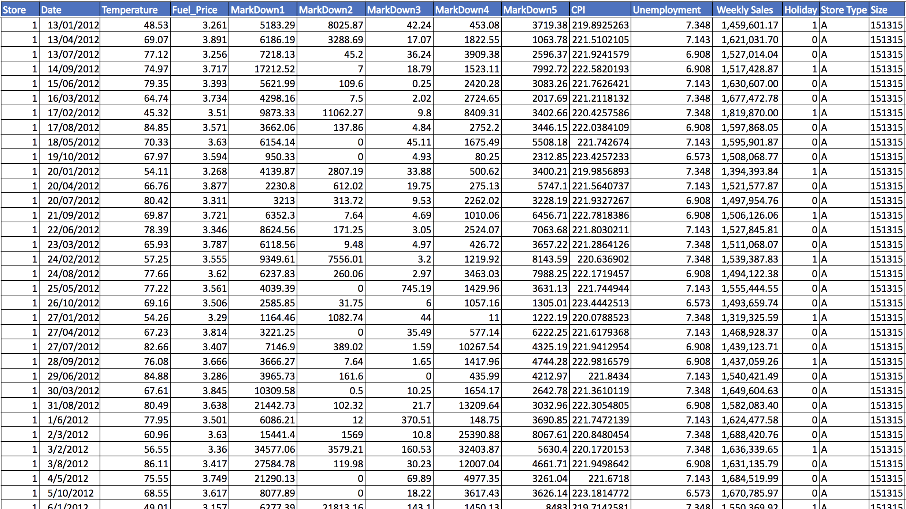
Notes:
Drew

Slide 6
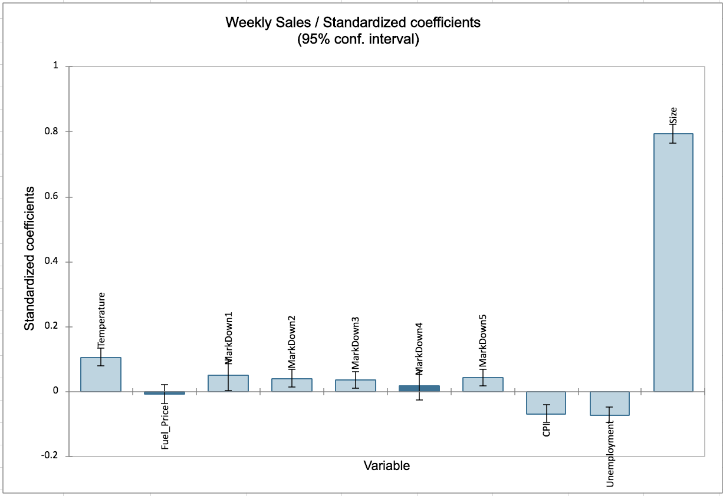
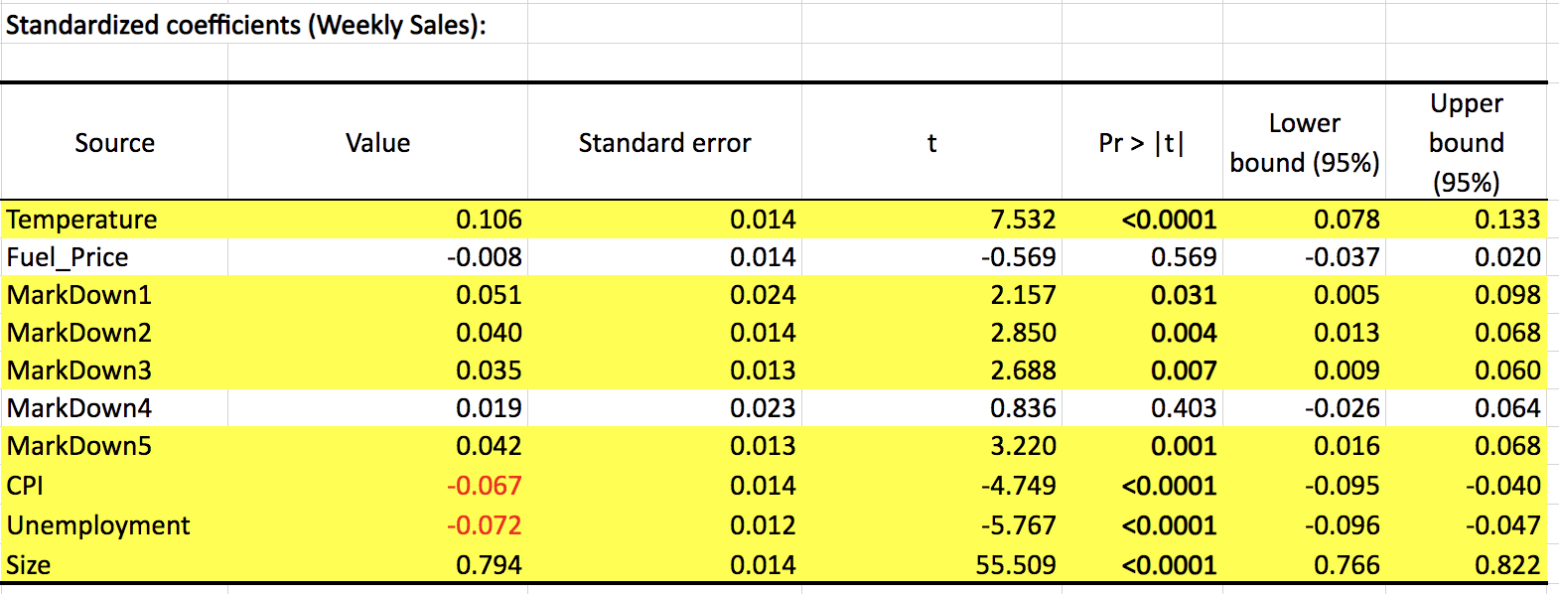
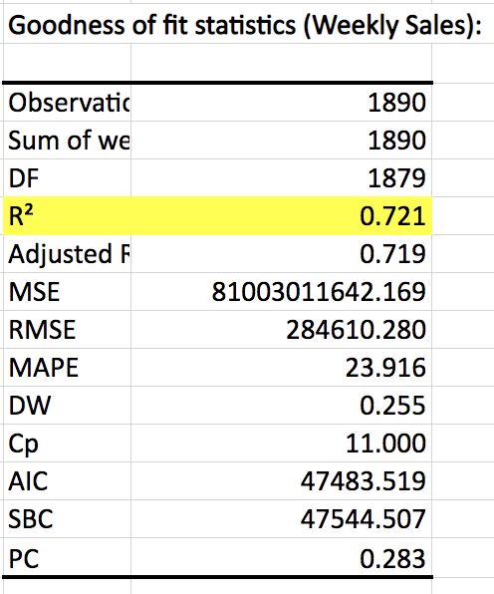
Linear Regression – ALL Variables
Notes:
Drew

Slide 7
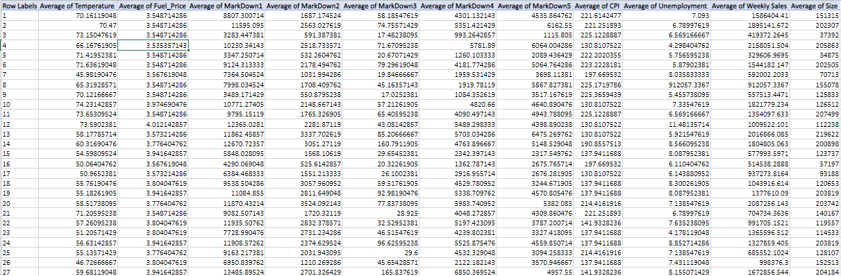
K-means Cluster Analysis – Areas of Focus
Notes:
Brandon-
After running our linear regression and seeing which variables were the most significant, the next step was to prep our data set for a k-means cluster analysis. Here we can see a snapshot of our data after taking the averages of all numerical values of importance. Now lets take a look at some interesting things we found after this analysis

Slide 8
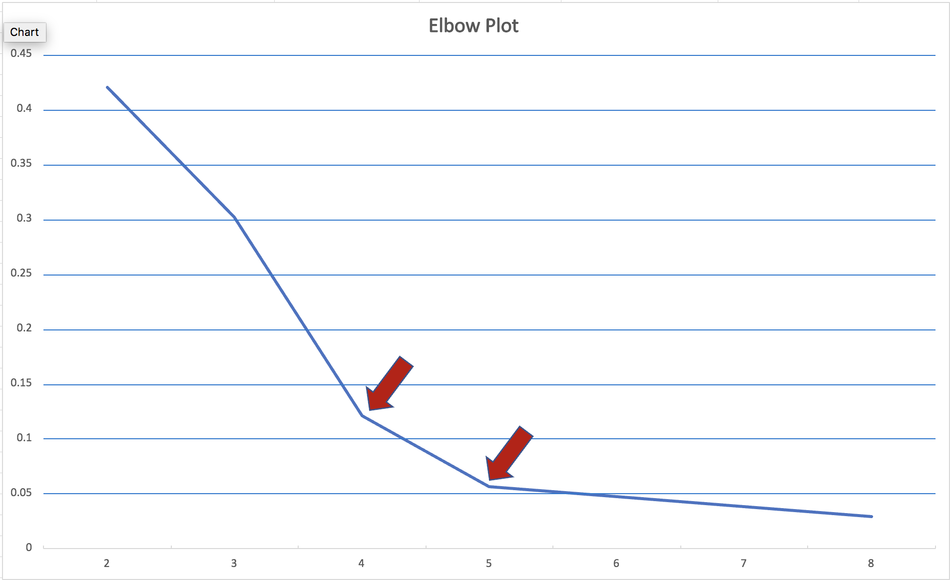
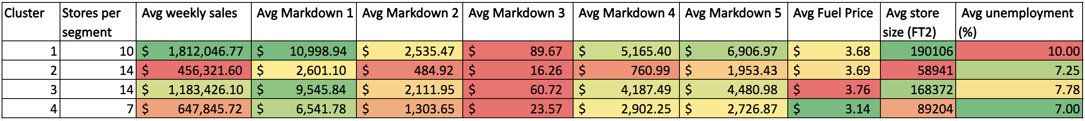
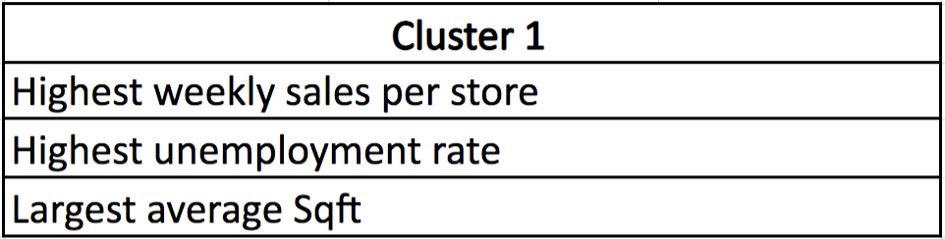
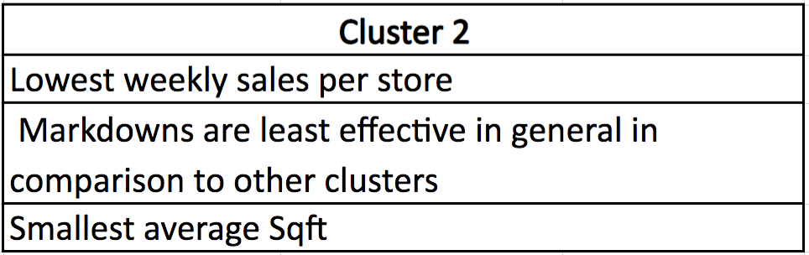
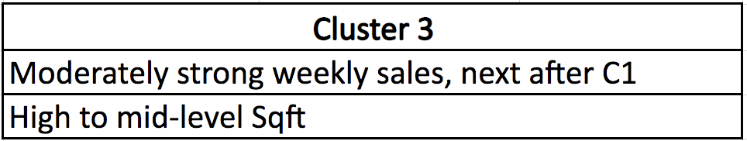
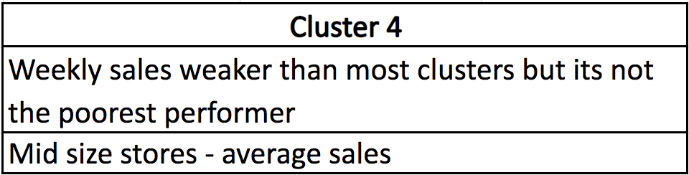
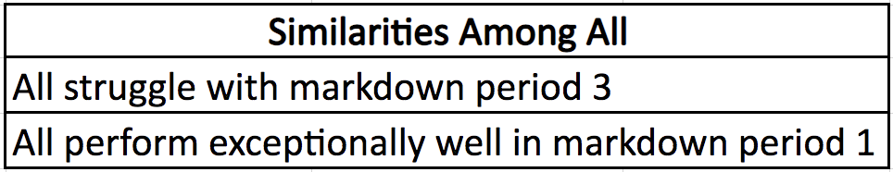
Cluster Analysis
Notes:
Brandon-
After running our cluster analysis we got this elbow plot on the top right and we noticed that we had a choice between 4 or 5 clusters. When we chose 5 clusters, we saw that there was only 1 store in cluster 5, so we chose to get rid of it and add the store to cluster 4. Some interesting takeaways are weekly sales being correlated to unemployment rate. For example, cluster 1 had the highest weekly sales per store and it also had the highest unemployment rate. We brainstormed why that may be the case, and a few possibilities are that maybe people have more time on their hands to go out and shop for groceries instead of being at work for most of the day OR they might just want to be more conservative with their spending so they turn to walmart who's known for low-cost items. We also saw that store size had an impact on weekly sales, which made a lot of sense. The bigger the store is, the more variety and products they can put on shelves. Which is why we see that cluster 2 has the lowest weekly sales. Markdown 1 was the best period overall. But above all, we saw that all clusters struggled with markdown period 3. Now let's take a look at what our linear regression models tell us about each cluster.

Slide 9
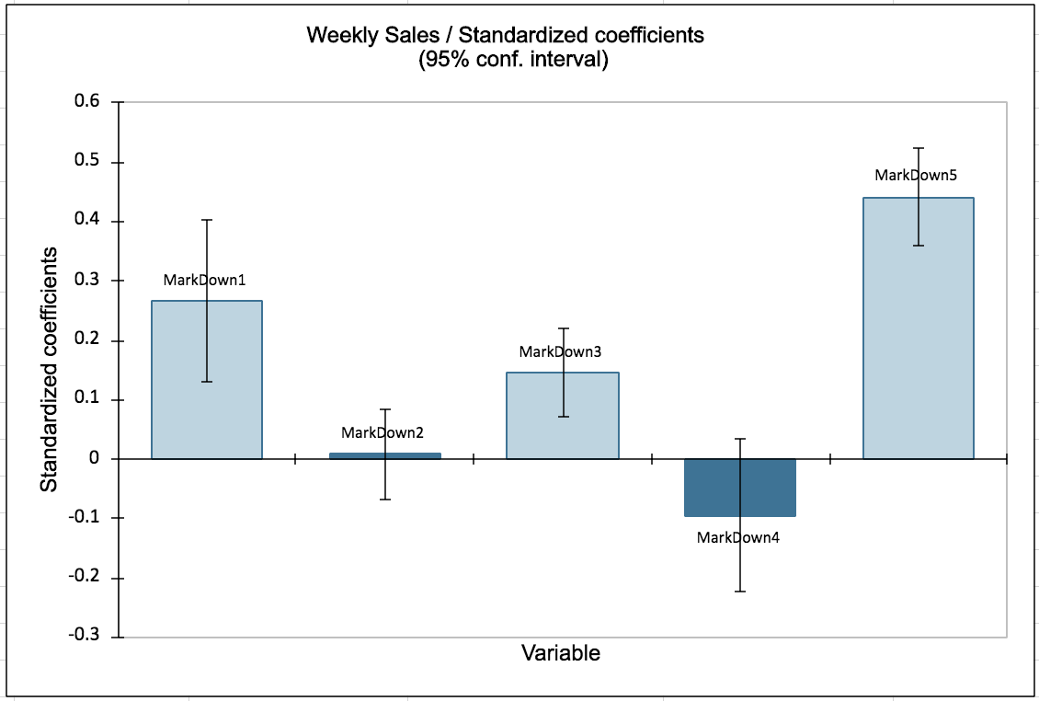
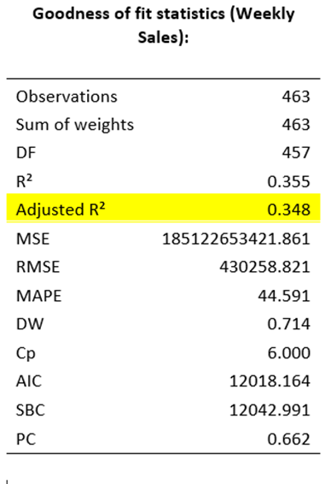
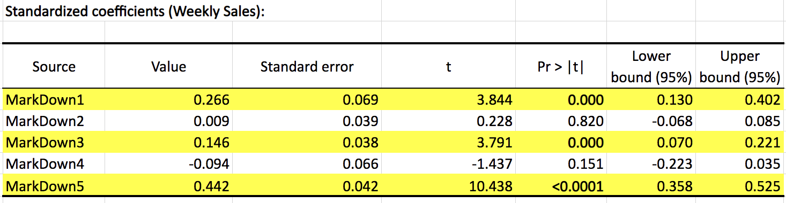
Linear Regression - Cluster 1
Observations
34.8% of variation in weekly sales is due to the 5 markdown periods
Markdowns 1,3 & 5 were significant and have positive impact on weekly sales
Notes:
Nick

Slide 10
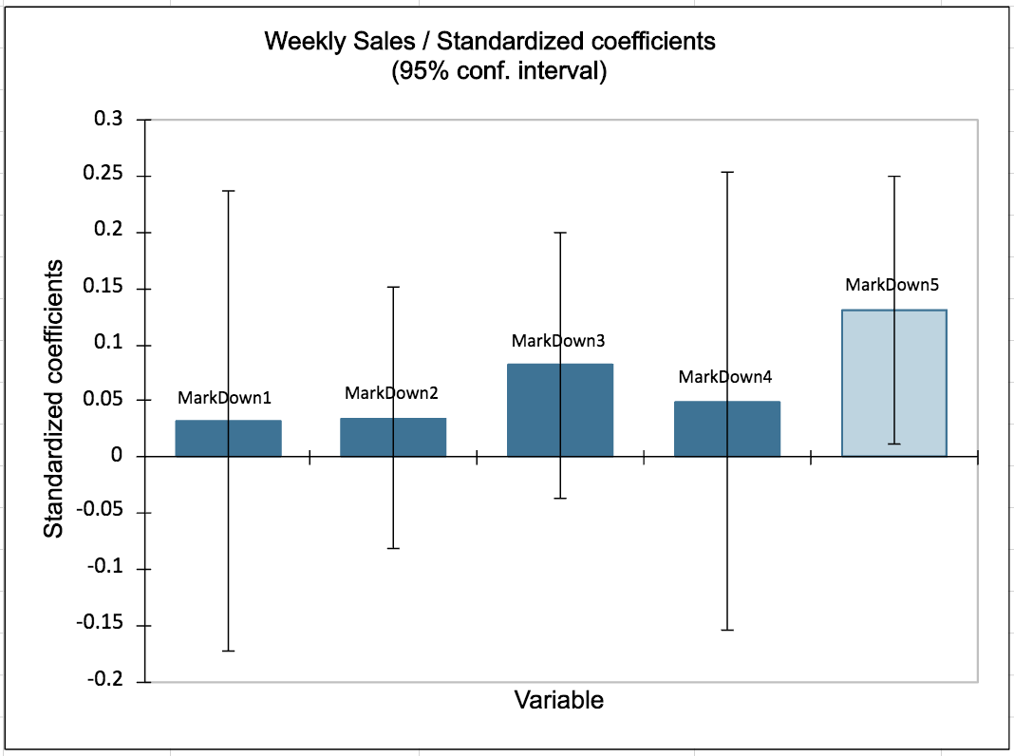
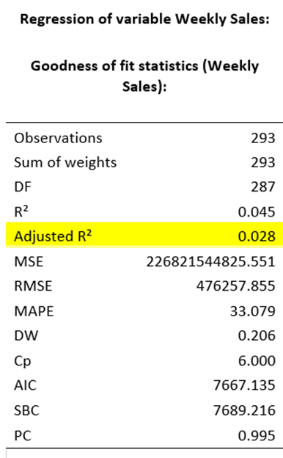
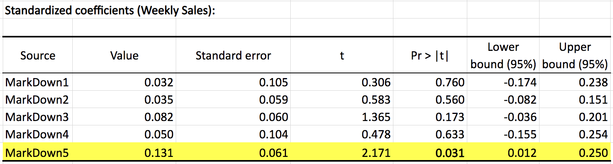
Linear Regression - Cluster 2
Observations
2.8% of variation in weekly sales is due to the 5 markdown periods
Only markdown 5 was significant and had a positive impact on weekly sales
Notes:
Nick

Slide 11
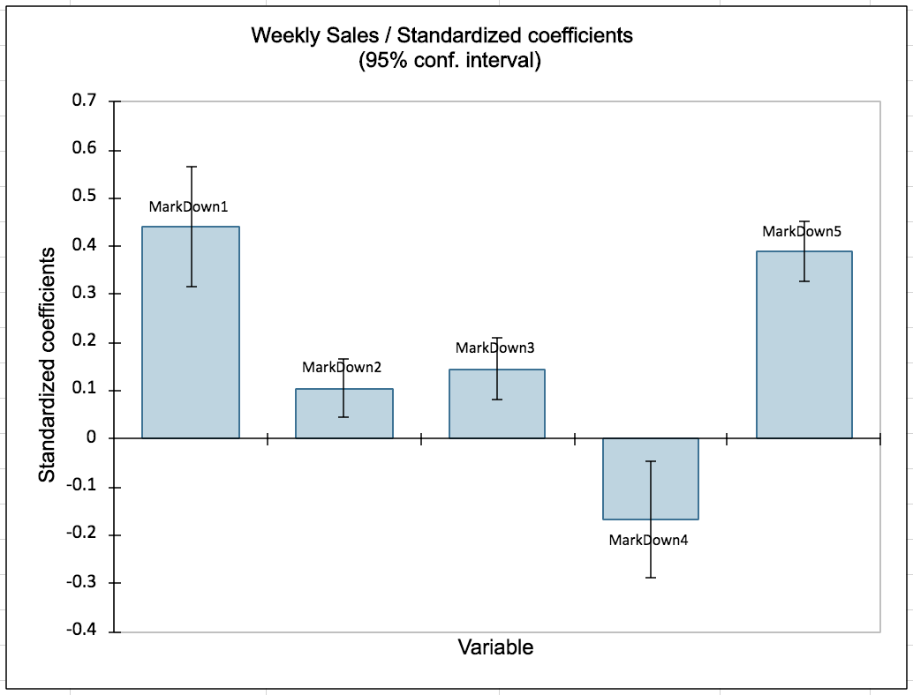
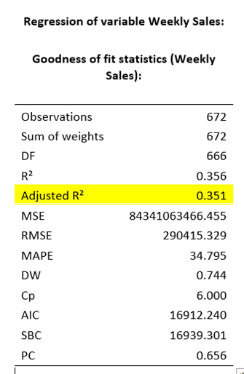
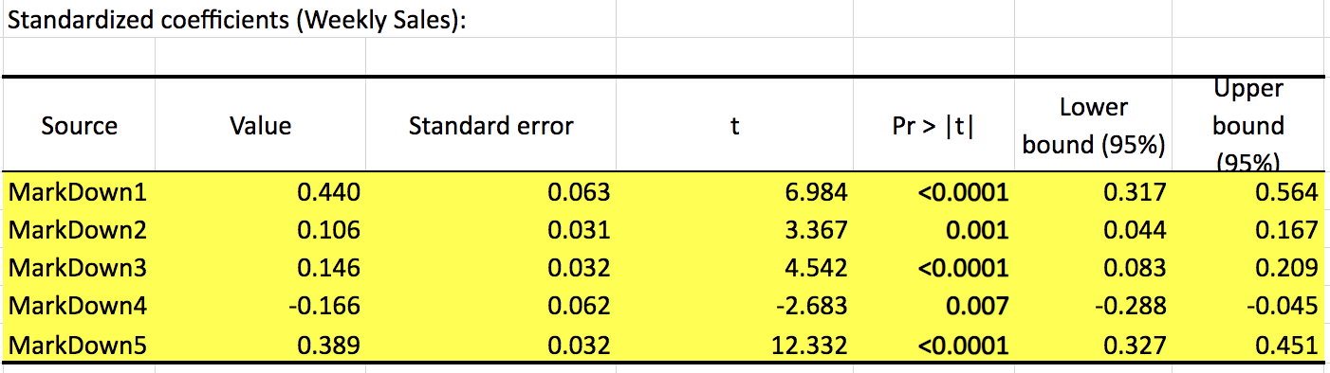
Linear Regression - Cluster 3
Observations​
35.1% of variation in weekly sales is due to the 5 markdown periods​
All markdowns significant and had a positive impact on weekly sales​
Notes:
Nick

Slide 12
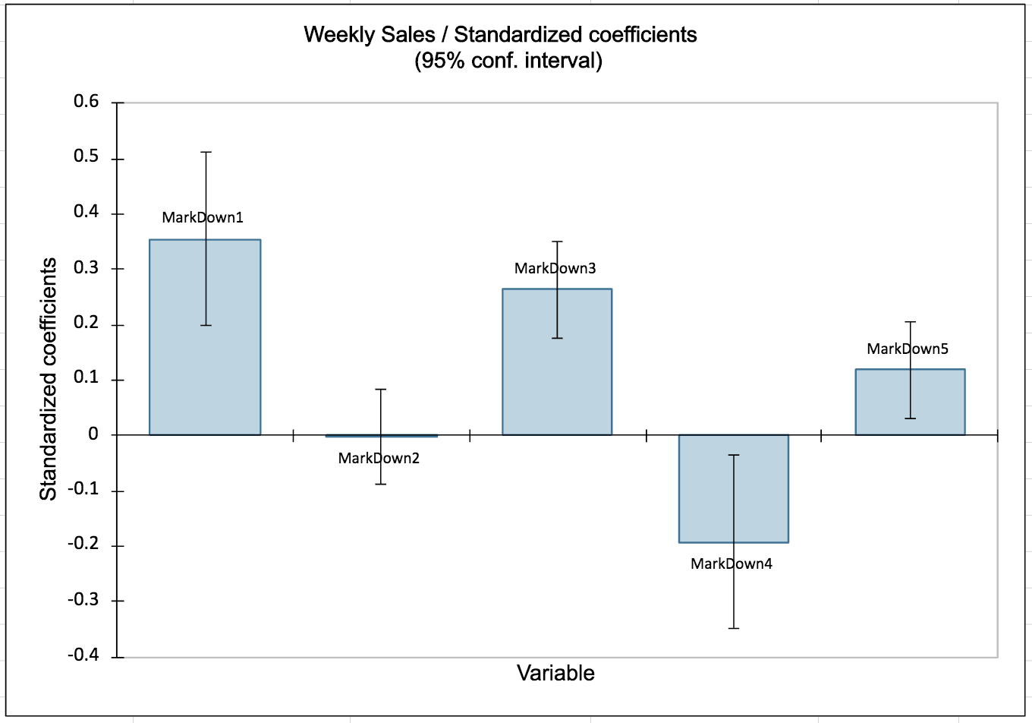
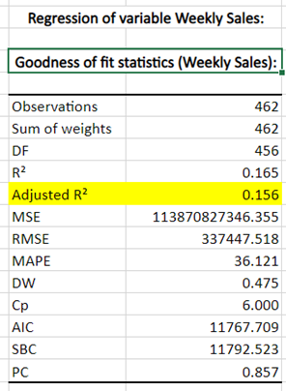
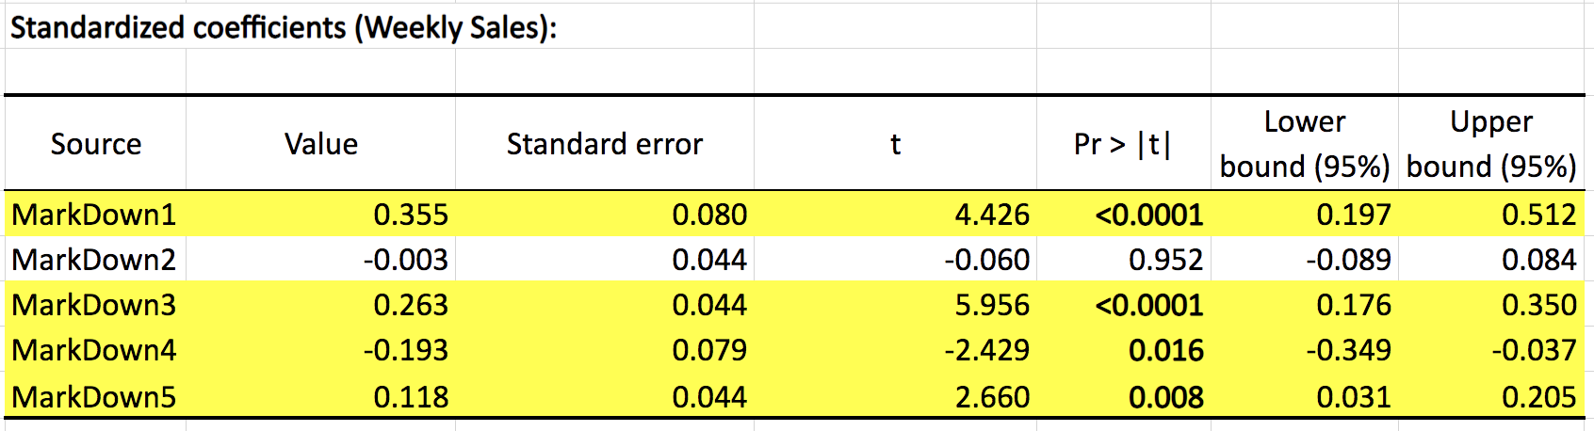
Linear Regression - Cluster 4
Observations​
15.6% of variation in weekly sales is due to the 5 markdown periods
Markdowns 1,3,4,5 were significant and had a positive impact on weekly sales​
Notes:
Nick

Slide 13
Conclusion & Recommendations
Cluster 1
Focus resources on markdown 1, 3, & 5 as they all contribute positively to the stores weekly sales.
Markdowns 2 and 4 were insignificant
Cluster 2
Markdowns 1-4 were found to be insignificant therefore we want to focus resources on markdown 5, which was statistically significant in cluster 2
Cluster 3
Focus resources on markdowns 1,2,3,&5 while continuing to analyze cluster data for future interpretation.
Markdown 4 is significant and negatively impacts sales. This markdown period should be eliminated.
Cluster 4
Remove Markdown Period 4 being that it is statistically significant and negatively impacts sales
Focus resources on markdowns 1,3, & 5.
Notes:
Ryan

